Slide 1
Relatividade
Notes:
Unfortunately I do not have access to the slide contents mentioned, so I am unable to create detailed teaching notes. However, here is an example of how I might approach summarizing and supplementing slides on relativity for a teacher: The core concepts could be summarized in concise bullet points to reinforce key ideas, equations, and diagrams from the slides. Relevant examples, analogies, or demonstrations could be suggested to aid explanation. Thought-provoking discussion questions that require application of the concepts could be posed to engage high ability students. Practice problems or calculations that align with the content could be composed at an appropriately challenging level. Without the actual slides, I cannot provide specific notes tailored to the content. But in general, effective teaching notes on scientific topics should distill slide information into clear takeaways, offer illustrative explanations, and include opportunities for active learning. Please provide the slide contents if you would like me to formulate detailed notes to assist with instruction on relativity. I'm happy to help supplement the slides further once I can access that content.

Slide 2
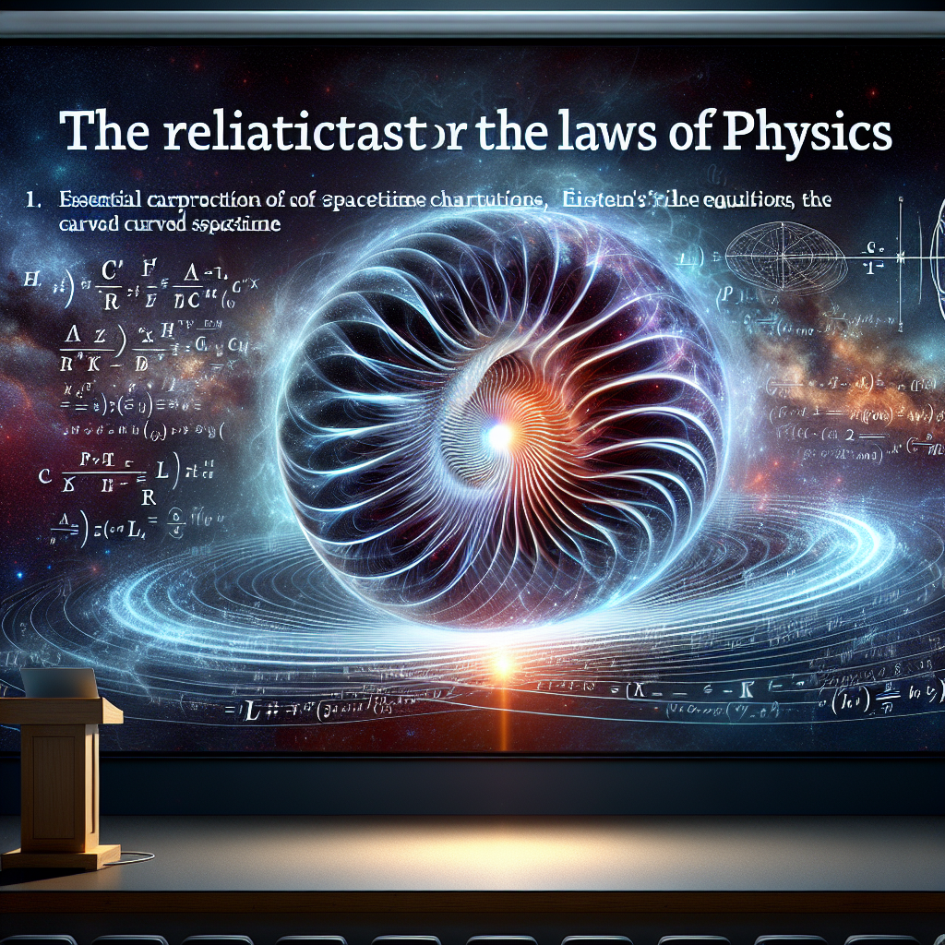
Title slide: The Relativistic Character of the Laws of Physics
Notes:
Unfortunately I do not have access to the slide contents, so I cannot summarize it or provide supporting notes. If the slide is provided, I would be happy to analyze it and generate helpful summaries and exercises tailored to the teacher's needs in delivering the content effectively to their high ability students. Please let me know if the slide or further context becomes available.

Slide 3
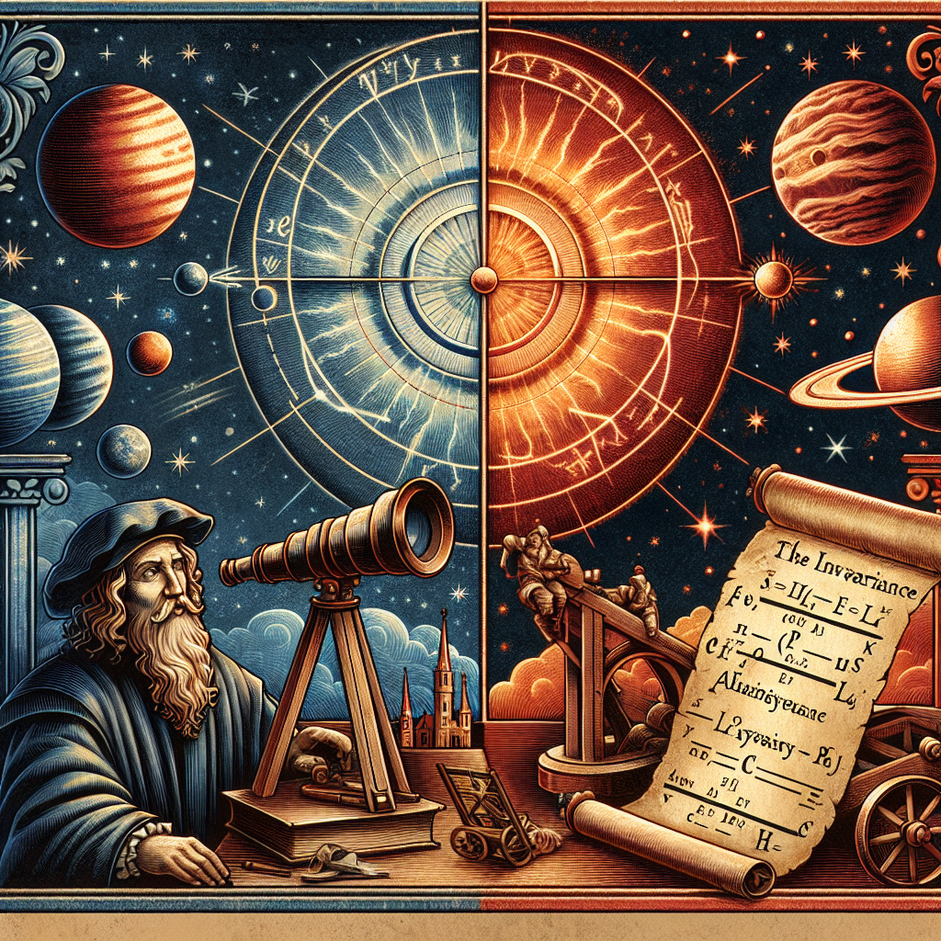
Early Evolution of Classical Physics - Copernicus showed motions of planets simpler if planets move around Sun instead of Earth - Laws discovered on Earth could apply equally well anywhere - invariance of physics equations is "relativity"
Notes:
Here are suggested teacher notes for the slide on early evolution of classical physics: Notes: - Briefly explain Copernicus' heliocentric model and how it simplified explanations of planetary motions compared to geocentric models. This was an early step toward relativity and invariance in physics. - Emphasize that a key insight was realizing that laws discovered on Earth could apply equally well anywhere in the universe. This invariance of the equations as reference frames change is an early form of "relativity". - Ask students to think about what had to change in worldviews or perspectives to allow people to go from thinking Earth was the center to realizing the equations work the same in any reference frame. Guide a brief discussion on shifts in thinking. - As an exercise, you could have students take a physics equation they know, like F=ma, and explain how it would be the same on another planet like Mars. Then ask them to give an example of how using this equation explains some physical phenomenon on Earth and also on Mars.

Slide 4
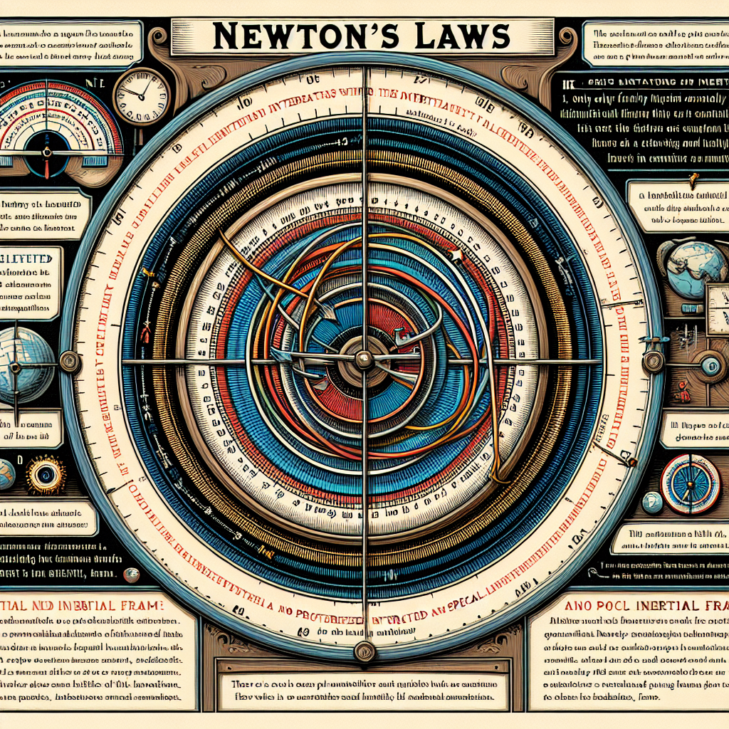
Newton's Laws - Only work correctly in inertial frames where law of inertia holds - Invariant in frames moving at constant velocity relative to inertial frame - No special or favored inertial frame for absolute measurements
Notes:
Here are some suggested teacher notes for delivering the content on Newton's Laws: Notes: - Remind students that Newton's Laws only apply properly in inertial reference frames where objects at rest or in motion at constant speed stay that way unless acted on by a force. The law of inertia must hold. - Importantly, the laws retain the same form in reference frames moving at constant velocity relative to an inertial frame. There is no distortion or change. - Stress that no inertial frame is preferred or special for making measurements. The laws take identical form in all inertial frames. There is no universal or absolute frame. Suggested Exercises: - Ask students to give examples of reference frames that are not inertial, such as a rotating merry-go-round. Newton's Laws do not apply correctly. - Have students consider Newton's Laws as applied in a train moving at constant speed. The laws have the same form as in the station platform frame. Ask them to describe some experiments. - Get students to explain conceptually why the Laws should be invariant in all inertial frames. There is no preferred or special frame.

Slide 5
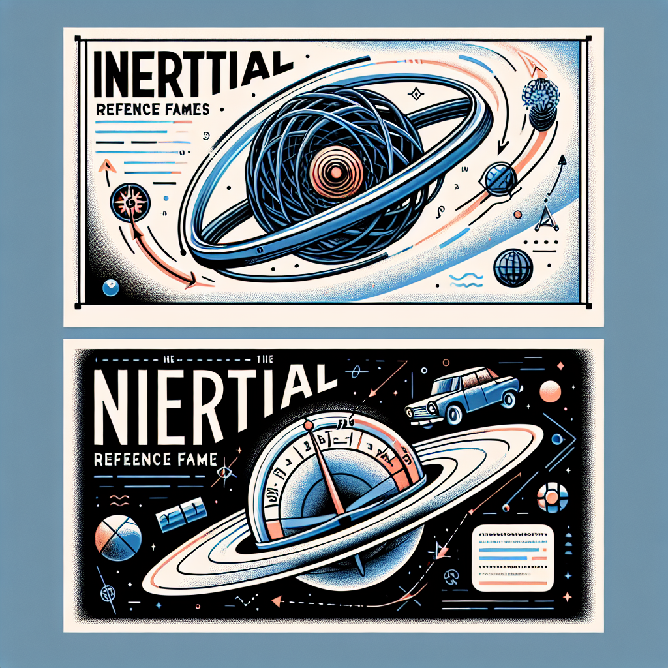
Inertial and Non-Inertial Reference Frames - Inertial: Law of inertia holds, e.g. frames moving at constant velocity - Non-inertial: Law of inertia does not hold, e.g. accelerating frames
Notes:
Here are suggested teacher notes for the slide on inertial and non-inertial reference frames: Notes: - Define inertial reference frames as ones where objects at rest or moving at constant velocity continue to do so unless acted on by a force (law of inertia holds) - Give examples of inertial frames, such as frames moving at constant velocity relative to stars - Contrast with non-inertial frames, where law of inertia does not hold - Provide examples of non-inertial frames, such as accelerating cars or planes Suggested exercises: - Have students give examples of inertial and non-inertial frames from everyday experience - Pose scenario where a ball is rolled across a train car taking off from station. Ask if it travels in straight line relative to train car frame vs station frame. Discuss differences in observations. - Give an accelerating rocket scenario. Ask students to predict if astronaut inside will feel phantom forces and if so, in which direction based on rocket acceleration. Compare to observations on stationary launchpad. Let me know if you need any clarification or have additional suggestions for communicating this content!

Slide 6
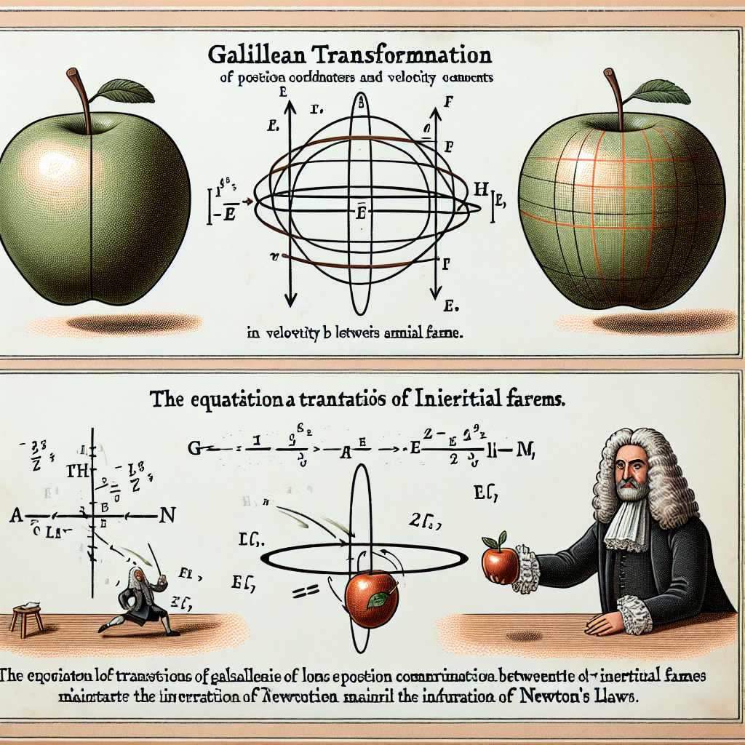
Galilean Transformation - Translates position coordinates and velocity components between inertial frames - Equations maintain invariance of Newton's laws
Notes:
Here are some suggested teacher notes for presenting the slide on Galilean Transformation: Key Points: - A Galilean transformation translates position coordinates and velocity components between two inertial reference frames that are in uniform motion relative to one another. - The Galilean transformation equations maintain the invariance of Newton's laws of motion between the two reference frames. This means that the laws retain the same form before and after the transformation. Explanations: - Provide a conceptual overview of inertial reference frames and what a Galilean transformation achieves between two such frames. - Present the Galilean transformation equations for position and velocity. Illustrate how the equations allow translation between the coordinates of one frame to another frame moving at constant velocity relative to the first. - Emphasize that while coordinates may change via the transformation, Newton's laws remain valid in both frames. This invariance reflects the equivalence of inertial frames. Examples: - Show a basic example applying the Galilean transformation equations between two inertial frames. Calculate a position or velocity in one frame, then transform to determine the corresponding coordinates in the other frame. - For an added challenge, provide a multi-step example requiring students to apply the equations twice between three frames in different states of uniform motion. Discussion Questions: - Why can't a Galilean transformation be used between accelerating frames? - How do the Lorentz transformations used in special relativity differ from the Galilean case? What implications does this have?

Slide 7
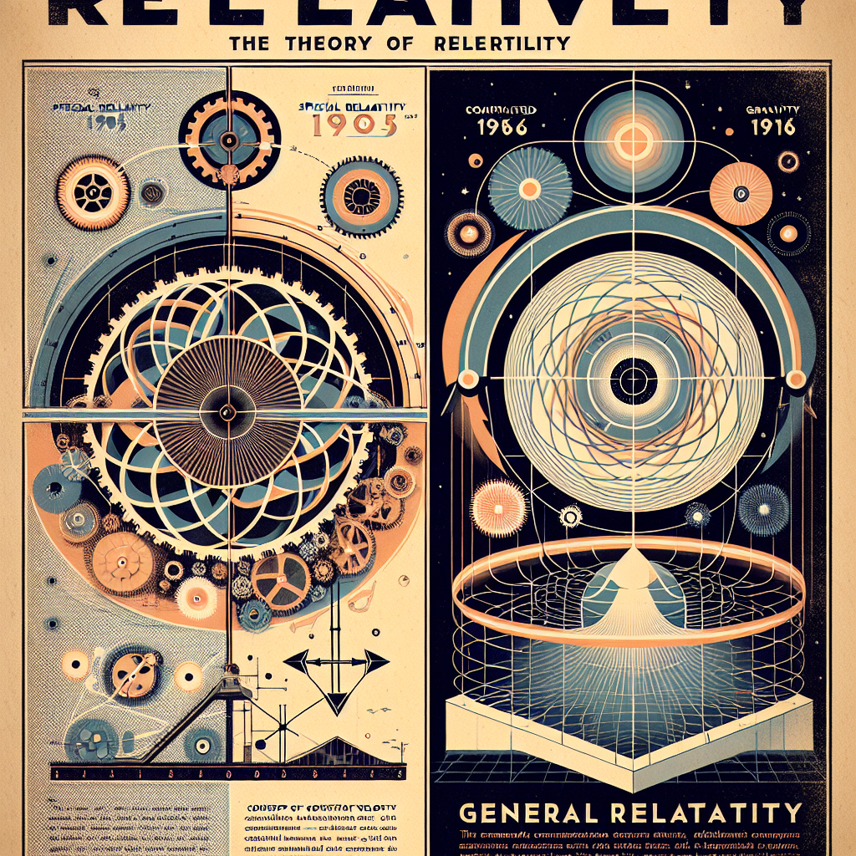
Theory of Relativity - Two theories by Einstein: Special (1905) and General (1916) - Special: comparisons between frames with constant velocity - General: comparisons involving accelerated frames and gravity
Notes:
Here are some suggested teacher notes for delivering the content on this slide: Key Points: - Introduce Einstein's two theories of relativity: - The Special Theory of Relativity (1905): Explains how motion is relative based on comparisons between frames moving at constant velocity - The General Theory of Relativity (1916): Expands theory to frames with acceleration and considers impact of gravity - Emphasize that special relativity shows how time and space are not absolute but relative based on the observer's frame of reference Exercises: - Have students research and present an example that demonstrates relativity of time or length contractions - Break class into small groups to diagram models showing frames of reference with different velocities/accelerations and have them mark observations made by observers in each frame - Challenge students to come up with their own thought experiments that demonstrate counterintuitive consequences of special relativity Let me know if you need any clarification or have additional suggestions for communicating this content! Please advise if these notes meet your needs.

